Slide 1
SDLC MODELS

Slide 2
SDLC Phases:
The 7 Phases Of SDLC (Software Development Life Cycle)
Stage 1: Project Planning.
Stage 2: Gathering Requirements & Analysis.
Stage 3: Design.
Stage 4: Coding or Implementation.
Stage 5: Testing.
Stage 6: Deployment.
Stage 7: Maintenance.

Slide 3
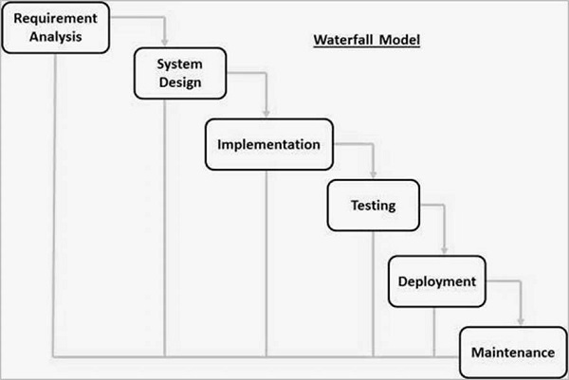
Waterfall Model :

Slide 4
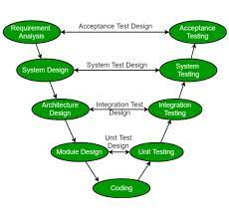
V Model :

Slide 5
V Model :
V-Model also referred to as the Verification and Validation Model.
In this, each phase of SDLC must complete before the next phase starts.
Verification: It involves a static analysis method (review) done without executing code. It is the process of evaluation of the product development process to find whether specified requirements meet.
Validation: It involves dynamic analysis method (functional, non-functional), testing is done by executing code. Validation is the process to classify the software after the completion of the development process to determine whether the software meets the customer expectations and requirements.

Slide 6
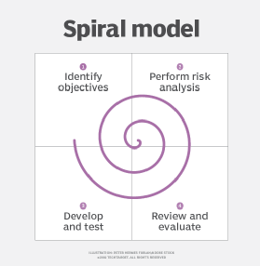
Spiral Model :

Slide 7
Spiral Model :
The Spiral Model is a Software Development Life Cycle (SDLC) model
Each loop of the spiral is called a Phase of the software development process.
Risk Handling, Good for large projects, Flexibility in Requirements etc.
Complex, Expensive, Time-Consuming, Too much dependability on Risk Analysis etc are disadvantages.

Slide 8
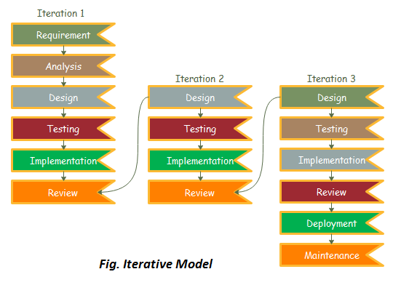
Iterative Model :

Slide 9
Iterative Model :
In this Model, you can start with some of the software specifications and develop the first version of the software.
When requirements are defined clearly and easy to understand we can use this.
When the software application is large also.
Easy to test as well.
More resources are used.

Slide 10
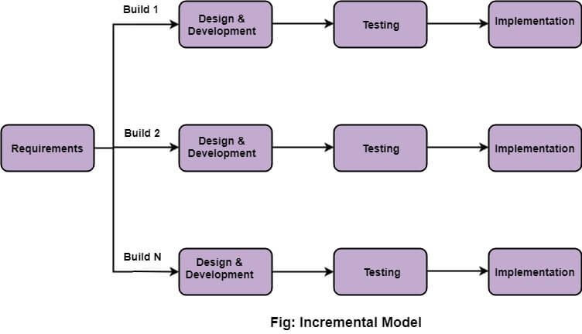
Incremental Model :

Slide 11
Incremental Model :
We have multiple versions in incremental models.
The software build will be updated at every version as well.
Based on the changes in requirments the software will be updates and releses new build as well.

Slide 12
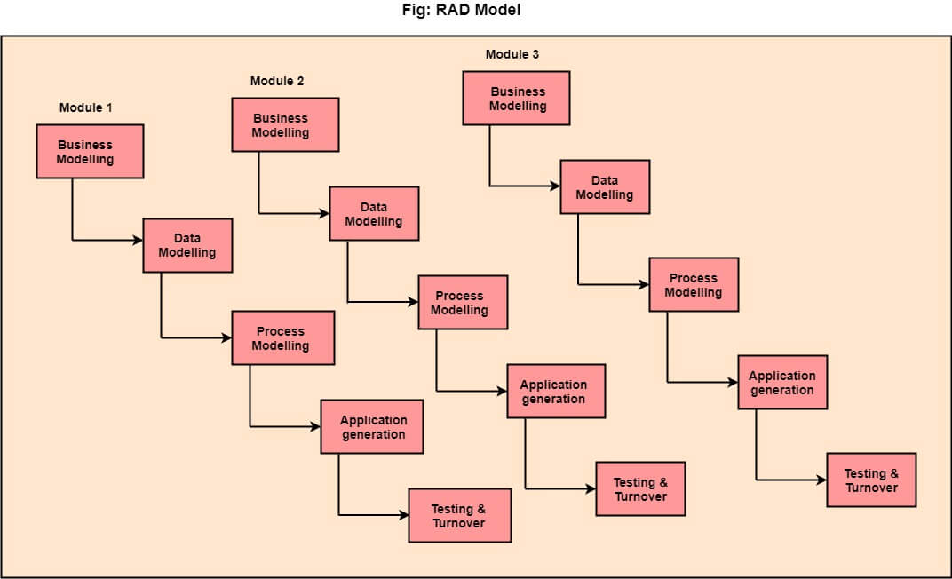
Rad Model :

Slide 13
Rad Model :
RAD stands for Rapid Application Development.
RAD is a linear sequential software development process model.
The re-use of software components.
Flexibility for changes as well.
Need high skilled persons to work.

Slide 14
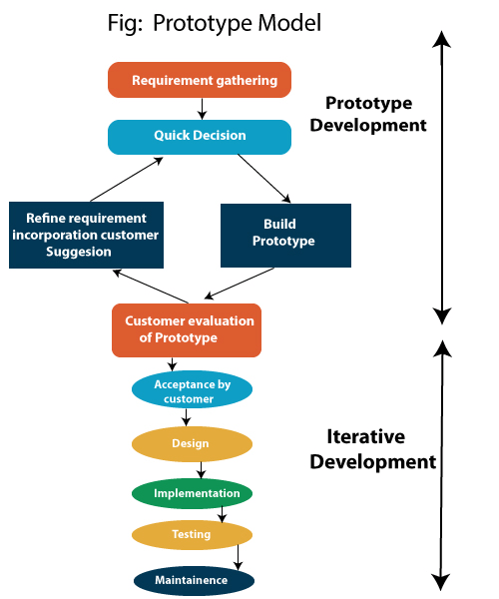
Prototype Model :

Slide 15
Prototype Model :
The prototype model requires that before carrying out the development of actual software, a working prototype of the system should be built.
In such a scenario where there is an absence of detailed information regarding the input to the system, the processing needs, and the output requirement, the prototyping model may be employed.
Advantage of Prototype Model
Reduce the risk of incorrect user requirement
Good where requirement are changing/uncommitted
Reduce Maintenance cost.
Errors can be detected much earlier

Slide 16
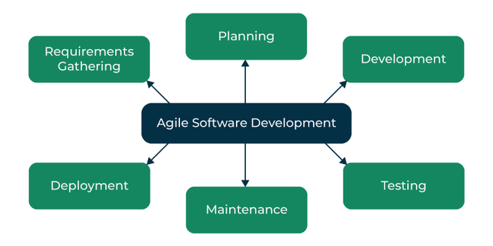
Agile Model :

Slide 17
Agile Model :
"Agile process model" refers to a software development approach based on iterative development.
Agile methods break tasks into smaller iterations, or parts do not directly involve long term planning.
Each iteration is considered as a short time "frame" in the Agile process model
Many frameworks like scrum framework etc.
Advantage of Agile Method:
1. Frequent Delivery
2. Face-to-Face Communication with clients.
3.Efficient design and fulfils the business requirement.
4.Anytime changes are acceptable.

Slide 18
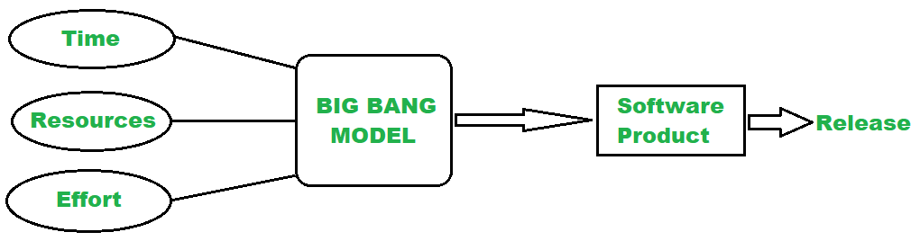
Big-Bang Model :

Slide 19
Big-Bang Model :
The Big bang model is an SDLC model that starts from nothing.
It is the simplest model in SDLC (Software Development Life Cycle) as it requires almost no planning.
However, it requires lots of funds and coding and takes more time.
Similarly, this SDLC model combines time, efforts, and resources to build a product.
Advantages of Big Bang Model :
There is no planning required for this.
Suitable for small projects
Very few resources are required.

